Slide 1
PX Analytics Progress Report
MVP Architecture and Implementation Github
Ankit Saha

Slide 2
Problem Statement
The Problem (Survey Bottleneck):
Post-visit surveys capture a low ~5% response rate.
Extreme selection bias (skewed toward highly satisfied or highly dissatisfied outliers).
Reactive data lagged by 30 days, disconnected from clinical workflows.
The Solution (Ambient PX):
Passive, ambient analysis of consultation audio ensuring a 100% capture rate.
Y-Split Processing: Decouples acoustic biometrics (tone, tempo) from semantic clinical charting to preserve patient privacy.
Actionable Output: Translates raw audio markers into standardized 0–100 metrics: Empathy, Clarity, and Efficiency.

Slide 3
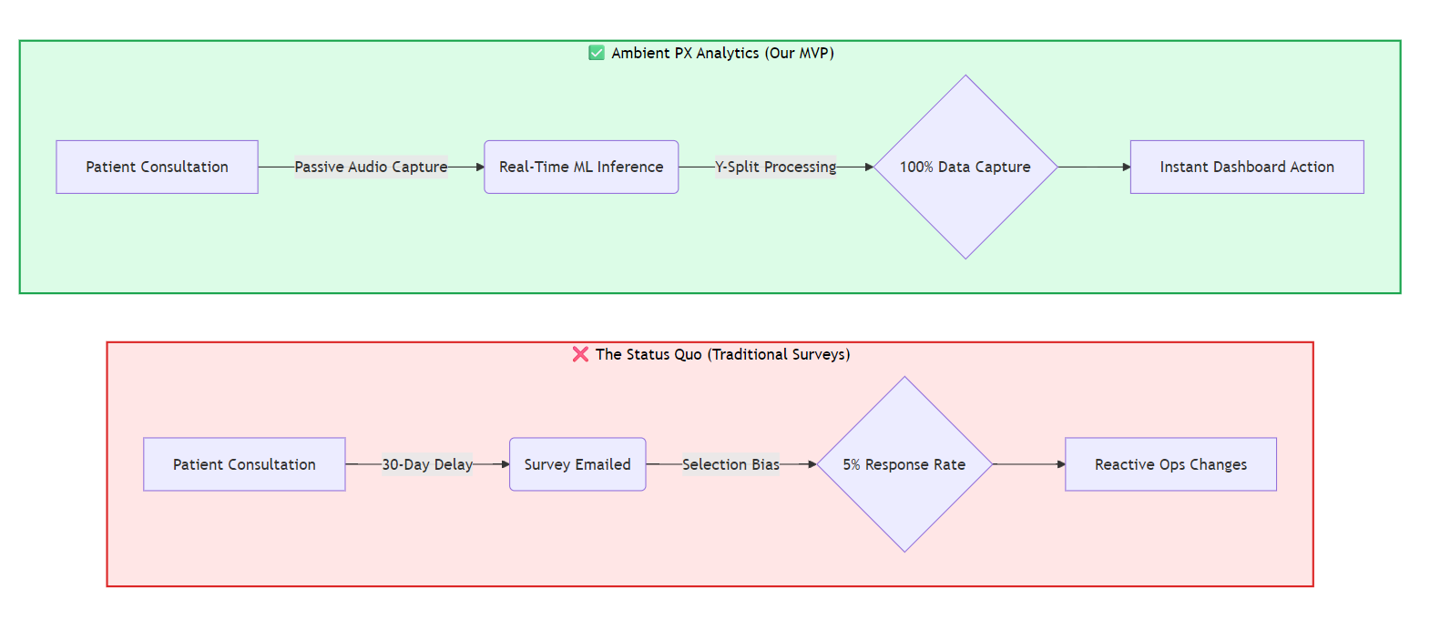
Problem Statement

Slide 4
System Architecture & Tech Stack
Frontend Layer (UI & Orchestration):
Vite, React 18
Tailwind CSS v4
Recharts
Lucide React.
Backend Layer (ML Inference API):
Python 3.13, FastAPI, Uvicorn, PyTorch, Librosa, NumPy.
Lightweight 112,968 parameter 1D-CNN optimized for low-latency CPU inference.
Database & Security Layer (Data State):
Cloud Firestore (NoSQL), Firebase Authentication.
Role-Based Access Control (RBAC) enforced strictly via server-side Firestore Security Rules.

Slide 5
End-to-End Operational Workflow
Ingestion: User uploads a .wav file via the Vite client interface.
Inference: File forwarded directly to the localized Python FastAPI server.
Feature Extraction: Librosa processes audio into a (41, 173) feature tensor (MFCCs + ZCR).
Classification: PyTorch 1D-CNN generates probability logits across 8 emotional classes.
Heuristic Mapping: Translation layer converts raw logits into 0–100 business scores.
Live Storage & Sync: Client appends the active provider_id, writes to Cloud Firestore, and triggers real-time Recharts visualizations via onSnapshot.

Slide 6
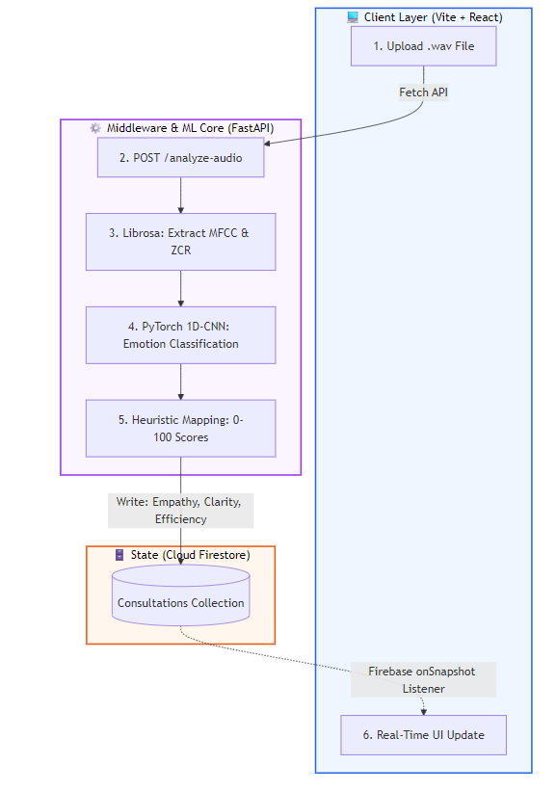
End-to-End Operational Workflow

Slide 7
Phase 1 — Acoustic Sentiment Engine
Objective: Extract experiential markers without Natural Language Processing (NLP) or transcriptions to guarantee compliance.
Dataset & Training: Trained on the RAVDESS emotional speech database (1,440 records, 8 distinct emotion classes).
Target Audio Features:
40 MFCCs: Captures vocal tract spectral shapes to isolate emotional tone
1 Zero-Crossing Rate (ZCR): Tracks acoustic frequency transitions to evaluate speech tempo and articulation.
Mapping Logic Formulas:
Empathy: Weighted positively by Calm/Happy logits; penalized by Angry/Fearful logits.
Clarity: Driven by a Gaussian curve centered on an ideal ZCR pacing coefficient (0.06).
Efficiency: Composite score balancing positive emotional valence against total stress markers.

Slide 8
Phase 2 & 3 — Infrastructure & Orchestration
API Integration: Enabled CORS Middleware on the FastAPI server to permit secure client-side fetch streams directly from the Vite application domain.
Firestore Schema Design
users: Stores UID, display names, and designated authorization roles.
providers: Tracks profiles, specializations, and historical performance rolling metrics.
consultations: Houses immutable logs composed of timestamp, provider_id, patient_anxiety_flag, and the {metrics} map.
RBAC Constraints:
Providers: Restricted via security rules to read only their specific session radar charts and timelines.
Admins: Unrestricted global read access across all hospital registries and benchmarking matrices.

Slide 9
Phase 4 — Live Dashboard Activation
Reactive State Plumbing: Eradicated hardcoded mock JSON arrays; bound Recharts data attributes directly to live Firestore document snapshot data streams.
Data Seeding Script: Implemented a standalone Node.js utility utilizing the Firebase Admin SDK to batch-inject 150 randomized consultations backdated across 30 days.
Simulated Visual Trends: Programmed the seeder to weight scores higher as timestamps approached the current date, generating an organic, trending performance line for demo visualization.

Slide 10
Next Steps
Model Scale: Transition from the lightweight 1D-CNN to a fine-tuned foundational audio Transformer architecture (e.g., Wav2Vec 2.0) for increased noise resilience.
Data Security Hardening: Build automated ephemeral data processing loops to immediately purge raw .wav binaries post-inference to maximize privacy.
Bias Evaluation: Implement continuous demographic audits to ensure the acoustic classification mapping performs equitably across diverse regional accents and dialects.

Slide 11
Thank You

